Slide 1
Identity Verification using Hand Geometry
Submitted By
Amit Kumar Gautam
Notes:
‹#›

Slide 2
Objective
Development of fast and reliable identity verification system.
Development of multiprogrammed client-server architecture with raspberry PI as client node.
Minimizing bandwidth between client and server for optimum usage of network
Notes:
‹#›

Slide 3
Motivation
Current biometric security measures can be easily cracked
Researcher printed fingerprint pattern using conducting ink to unlock fingerprint locked phones.
Similarly token systems can be forged and password systems can be brute forced or remembered.
Notes:
‹#›

Slide 4
Motivation
Current security measures are costly and time consuming.
They are not very useful for real time applications
Impractical to implement as distributed system.
Notes:
‹#›

Slide 5
Motivation
Systems which use fingerprint scanners are unable to detect patterns of children and workers because extensive use of hand causes pattern deterioration.
Many children and workers dont have aadhar card yet because scanner could not get any input.
Notes:
‹#›

Slide 6
Methodology
Requesting PIN
A person has to enter PIN which directs database to use respective feature vector as reference for matching.
Notes:
‹#›

Slide 7
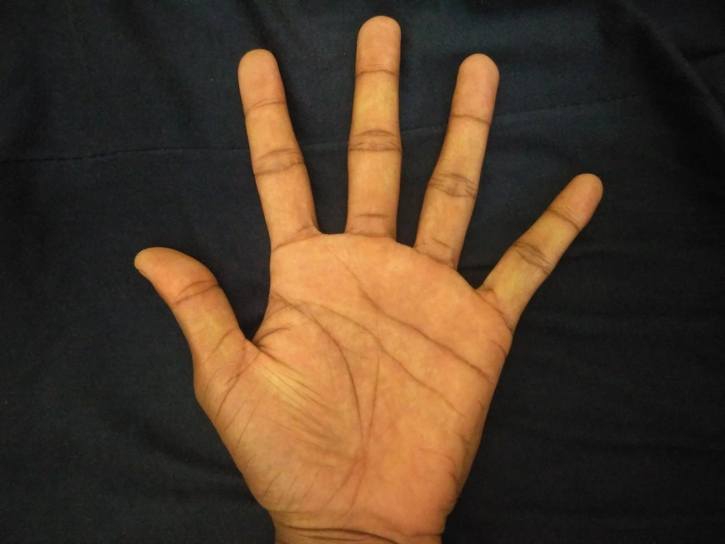
Image Acquisition
Notes:
‹#›

Slide 8
Methodology
Extraction of required region
First image will be converted into a grayscale image.
From grayscale ,we will convert it into a binary image using threshold
Threshold value we used here is 65.
Notes:
‹#›

Slide 9
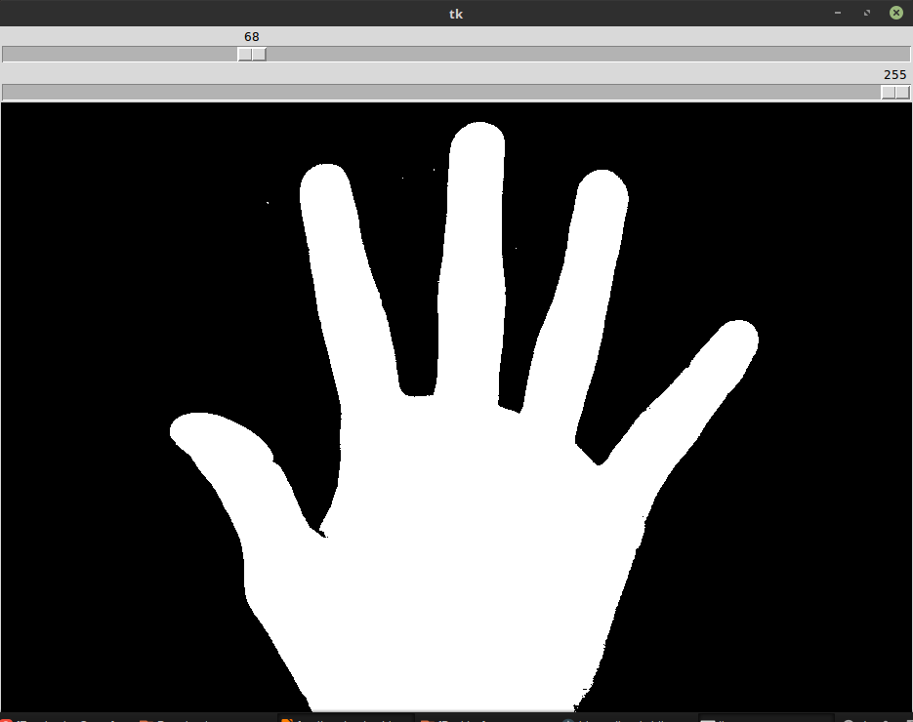
Extraction of Required Region
Notes:
‹#›

Slide 10
Methodology
Contour Extraction
After converting the image into a binary image we extracted the contour of image.
Notes:
‹#›

Slide 11
Methodology
func start_point: return pixel
while i < num_rows:
while j < num_columns
if image[i][j] == 1:
return image[i][j]
j:=j+1
i:=i+1
func cracks(start_point): return list of pixels
return function_cracks(start_point.left)+
function_cracks(start_point.down)+
function_cracks(start_point.right)+
function_cracks(start_point.up)
Notes:
‹#›

Slide 12
Methodology
Contour approximation
After extracting the contour of image we approximate the contour.
Approximation was done because contour on finger tips wasn’t smooth.
Notes:
‹#›

Slide 13
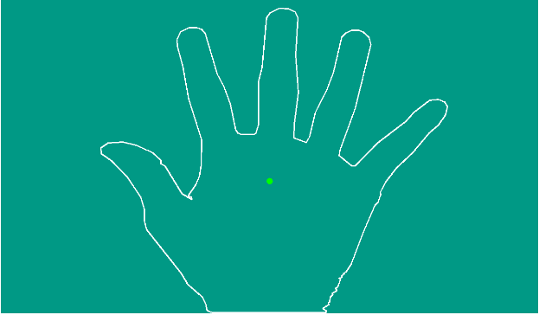

Slide 14
Methodology
Generating Moment and Centroid
We generated the moment using cv2.moment which is a inbuilt function in opencv.
From moment we also calculated the centroid of the image .
Notes:
‹#›

Slide 15
Methodology
Notes:
‹#›

Slide 16
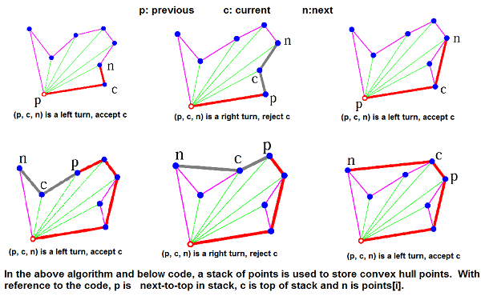
Graham Scan for convex hull
Notes:
‹#›

Slide 17
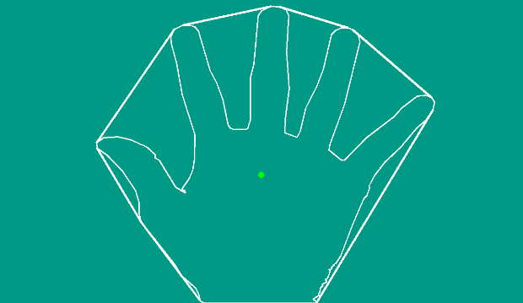

Slide 18
Methodology
Finding Valleys in Image
5 valley point were extracted using convex hull and contour .
Generate all distance vectors perpendicular to hull line to contour and extract the longest one.
- Extract five points from minimum distance with centroid
Notes:
‹#›

Slide 19
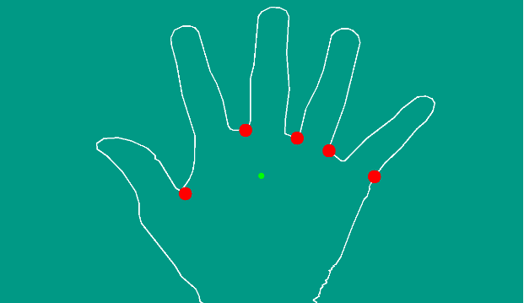

Slide 20
Methodology
Finding Tip Points in Image
We use valley points average and cenroid for the extraction of peak points.
Extract all points on the hull who are above centroid.
Notes:
‹#›

Slide 21
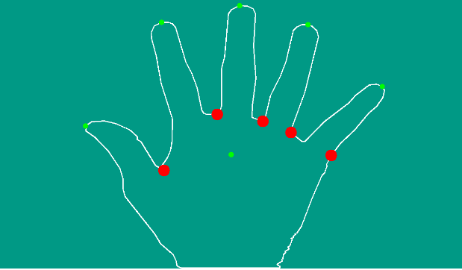

Slide 22
Methodology
Extraction of Knuckle Points
Middle points of valleys will be used as knuckle points of fingers.
For the extraction of knuckle point of thumb we used intersection of lines between forefinger valley and thumb valley with thumb tip and drop of centroid.
Notes:
‹#›

Slide 23
Methodology
Distance Between Knuckle Point and Tip Point
7 distances will be considered.
5 lengths of each finger.
Distance between thumb joint and index finger joint.
Distance between index finger joint and little finger joint.
Notes:
‹#›

Slide 24
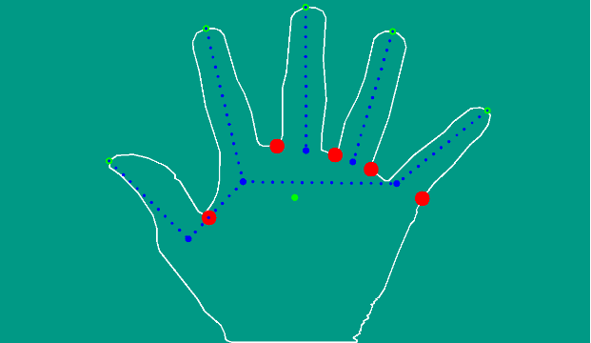
Notes:
‹#›

Slide 25
Methodology
Matching
Data will be sent to server.
Server will compare the data with reference feature if PIN is found in database.
If distance between two lies below some threshold then result is true otherwise result is false.
Server will respond to client in one of TRUE, FALSE and PIN error.
Notes:
‹#›

Slide 26
Client side
Acquire PIN and Image
Acquire contour of hand
Detect peak and valley
Calculating and sending 7 distances with PIN.
Wait for reply
Notes:
‹#›

Slide 27
Flowchart
Notes:
‹#›

Slide 28
Example of a database
PIN | Dist 1 | Dist 2 | Dist 3 | Dist 4 | Dist 5 | Dist 6 | Dist 7
Note: PowerPoint does not allow have nice default tables – but you can cut and paste this one
Notes:
‹#›

Slide 29
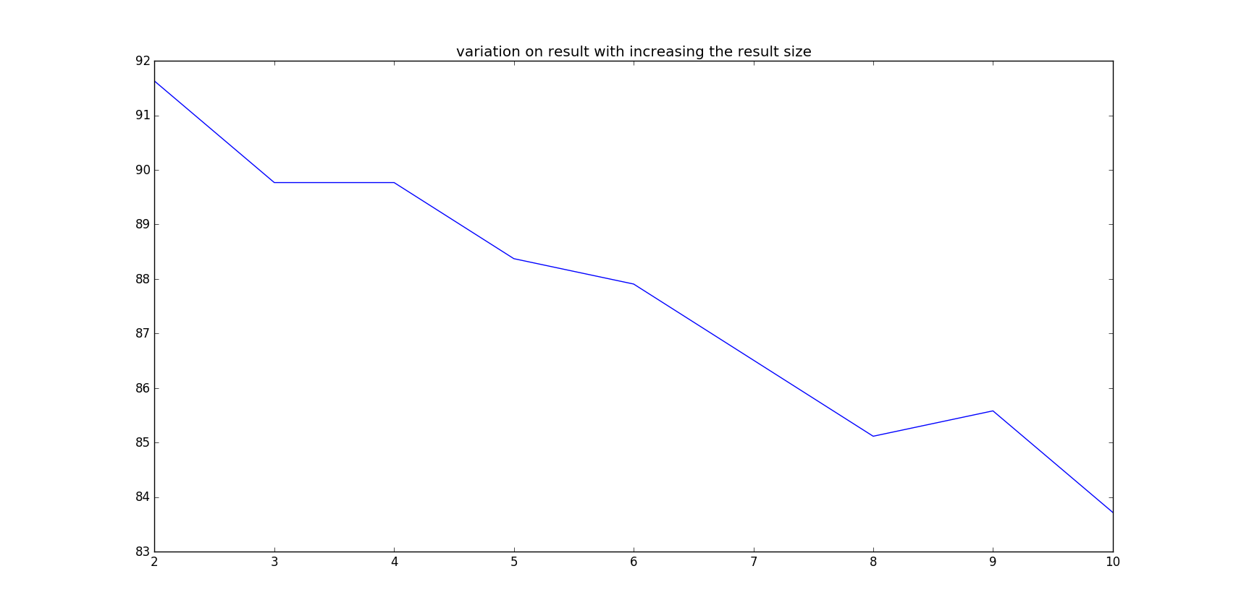
Result
Notes:
‹#›

Slide 30
Thank You
Notes:
‹#›

